Slide 1
Enterprise Requirements Analysis
Lecturer: Ngo Huy Bien
Software Engineering Department
Faculty of Information Technology
VNUHCM - University of Science
Ho Chi Minh City, Vietnam
nhbien@fit.hcmus.edu.vn

Slide 2

Objectives
To draw and document analysis models for enterprise system.
To write a software requirement specification for enterprise system.
To validate a software requirement specification for enterprise system.

Slide 3

Contents
Requirements Analysis
Domain Analysis
The Zachman Framework

Slide 4

References
David C. Hay (2002). Requirements Analysis - From Business Views to Architecture. Prentice Hall PTR.
Kyo C. Kang et al. (1990). Feature-Oriented Domain Analysis (FODA).
Klaus Pohl et al. (2005). Software Product Line Engineering: Foundations, Principles, and Techniques. Springer.

Slide 5

Requirements Analysis [1]
Requirements analysis can be seen as the process of translating the business owners' views of an enterprise into an architect's view that can be the basis for future systems development.
Thousands of software projects are doomed from the start because they're based on a faulty understanding of the business problem that must be solved.

Slide 6


Important Note
Business problems, not system features.

Slide 7


The Core Idea
Indentify problems in an enterprise.
Problem space = Real world + Technology.
Requiring both domain experts and technical experts.

Slide 8


Slide 9

Domain Analysis Terms (I) [2]
Application: A system which provides a set of general services for solving some type of user problem.
Context: The circumstances, situation, or environment in which a particular system exists.
Domain: (also called application domain) A set of current and future applications which share a set of common capabilities and data.

Slide 10
Domain Analysis Terms (II)
Domain analysis: The process of identifying, collecting, organizing, and representing the relevant information in a domain based on the study of existing systems and their development histories, knowledge captured from domain experts, underlying theory, and emerging technology within the domain.
Domain engineering: An encompassing process which includes domain analysis and the subsequent construction of components, methods, and tools that address the problems of system/subsystem development through the application of the domain analysis products.

Slide 11
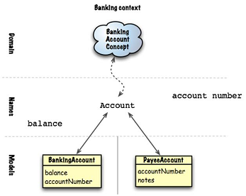
Domain Analysis Terms (III)
Domain model: A definition of the functions, objects, data, and relationships in a domain.
Feature: A prominent or distinctive user-visible aspect, quality, or characteristic of a software system or systems.
Software architecture: The high-level packaging structure of functions and data, their interfaces and control, to support the implementation of applications in a domain.

Slide 12
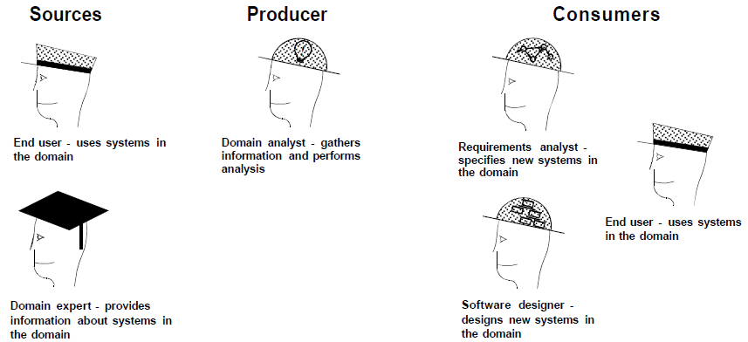
Domain Analysis Participants

Slide 14
Analysis vs. Design [1]
Analysis is concerned solely with what some call the problem space or the universe of discourse: What is the nature of the enterprise and how does it use information?
Design, in the solution space, is the specific application of particular technology to address that enterprise.
Business experts' view ➾ the architect's view ➾ designer's view.
If a programmer speaks to a business expert and then turns around and produces a system, he or she has just done those two translations—unconsciously. The problem is that no one is in a position to evaluate the quality of either translation.

Slide 15
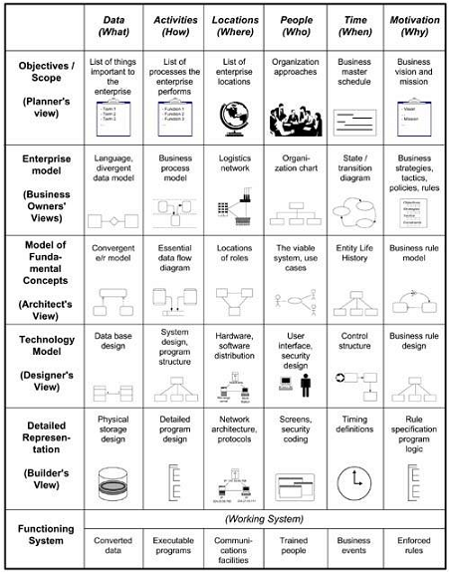
The Zachman Framework

Slide 16
The Analysis Process
A business owner's view is usually expressed in terms of industry jargon and is about the mechanisms involved in running the enterprise today.
Requirements analysis must analyze this to determine the fundamental structures and functions of the business, in order to suggest new ways that these might be addressed.
What to create?
Models: Data, Activities, Locations, People and Organizations, Timing, Motivation.

Slide 17
1. Gather Information
Meet with the people who will own the system.
They are the ultimate source of all your information about the company and what it should do.
Conduct briefing.
Conduct interviews.
Conduct "joint application development" (JAD) sessions.
Obtain industry information and patterns.
Seek out information about how other companies in this industry work.
A similar project is very likely to have been done before in another company. Take advantage of that, if possible.
Review the range of available software.
The primary result of this process is not a formal deliverable.
It is a set of notes and sketches.

Slide 18

2. Define Scope
What is the project about?
What information-processing capabilities is it to create?
What part of the enterprise is it to address?
Who is assigned to the project?
Who is ultimately responsible for it?
Who owns the data and functions involved?

Slide 19

3. Take Inventory of Current Systems
While requirements analysis, for the most part, is not concerned with technology or current systems, it is useful to know what exists, and what roles technology plays in the current operation of the enterprise.

Slide 20
4. Describe the Enterprise
Use the modeling techniques to portray the six dimensions of the enterprise: what data, how it is processed, where things are done, who plays what roles in the enterprise, when events take place that trigger activities, and why the enterprise is constrained the way it is.
The enterprise is described by a series of graphic and textual models.
Data (object class) models, activity models, location models, people and organization models, event and timing models, motivation models.
It is necessary to present models.
The deliverable from this process is a set of models, fully documented.

Slide 21

Question
How do we describe the enterprise?

Slide 23
Data Views
Business Owners' Views (2nd Row)
language: glossary & business objects
A PROFESSOR teaches a COURSE in a CLASSROOM.
Architect's View (3rd Row)
VENDORS, CUSTOMERS, EMPLOYEES
In the architectural model, these are replaced with PERSON, and ORGANIZATION with a super-type called PARTY, where a PARTY is defined as either a person or an organization of interest to the enterprise.
Designer's View (4th Row)
What you see in Row Four depends on the technology you will be using: A relational designer sees tables, columns, and foreign keys; an object-oriented designer sees classes, attributes, and associations to be navigated.

Slide 24
Data Modeling Conventions
Syntactic conventions are about the symbols to be used.
Barker's technique, the UML, and IDEF1X are all examples of syntactic conventions.
Semantic conventions describe standard ways for representing common business situations.
Data model patterns, analysis patterns

Slide 25
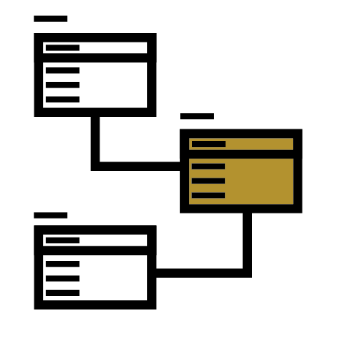
Data Modeling Artifacts [3]
Data modeling focuses on the data processed and stored in a system as well as the relations between the data.
A popular data modeling approach is the entity relationship model.
Class diagrams document the essential entities of the system under consideration.

Slide 26
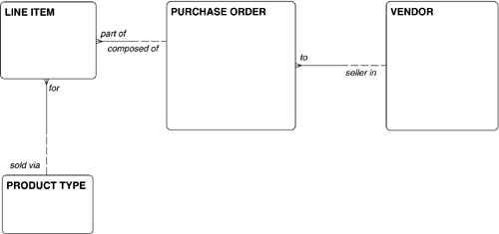
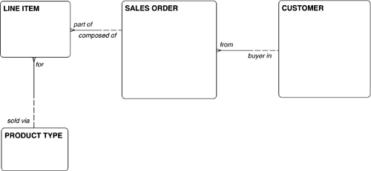
Purchase Orders & Sales Orders Example

Slide 27
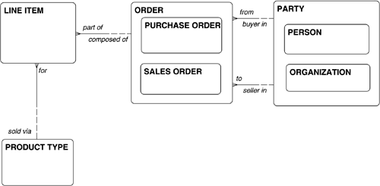
Orders Example

Slide 28
Data Model Validation [1]
Making sure that the syntax is correct.
Making sure that industry standard conventions for representing standard situations were at least consulted.
It should be reviewed with subject matter experts to ensure that the assertions made in the model are in fact true in the business.
It should be tested for intellectual rigor. Is it consistent and coherent?
Scenarios or use cases
Sample data

Slide 29
Entity/Relationship Model Validation

Slide 31
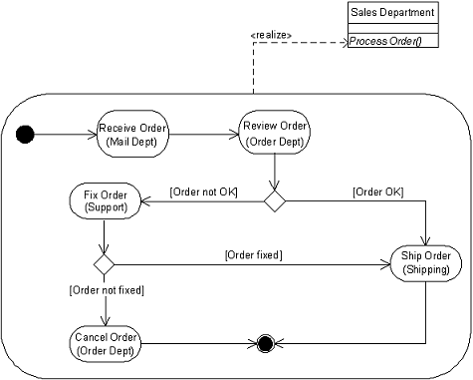
Behavioral Modeling [2]
Behavioral requirements can be modeled in different ways, e.g. in terms of actions, interactions or state transitions.

Slide 32
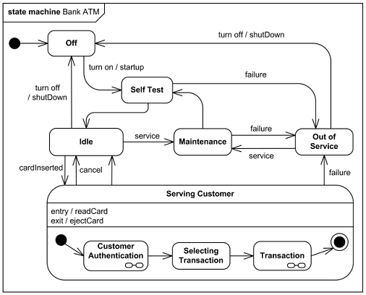
State Machine Diagram
A state machine diagram depicts discrete behavior modeled through finite state-transition systems.
In particular, it specifies the sequences of states that an object or an interaction goes through during its life in response to events, together with its responses and actions.

Slide 33
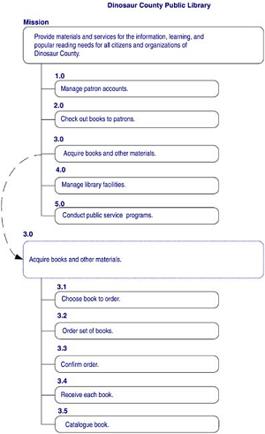
Function Hierarchies [1, 3]
Functional analysis is based on decomposing the system under consideration into a set of functions and their interrelations.
A hierarchical representation of the functions of the enterprise.
There are actually four ways you can break down a function
Decomposition
Sequence
Organization
Split by Type

Slide 34
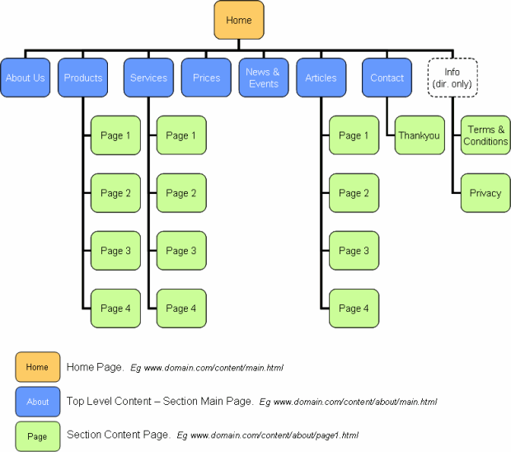
Functions Navigation

Slide 35
Data Flow Diagrams [3]
The data flow diagram (DFD) is used in structured analysis.
It documents graphically:
The data flows of a system.
The manipulation of data (functions or processes).
The location of persistent data (data stores).
The data sources and sinks outside the context of the system.

Slide 36
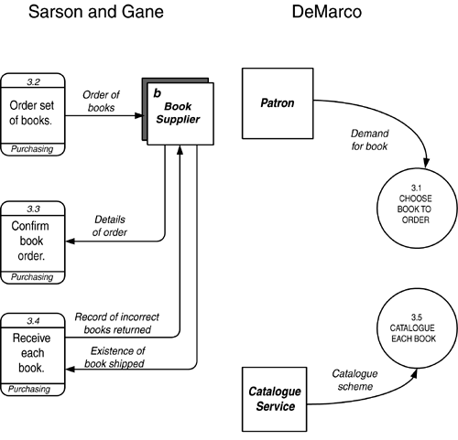
Data Flow Diagrams [1]

Slide 37
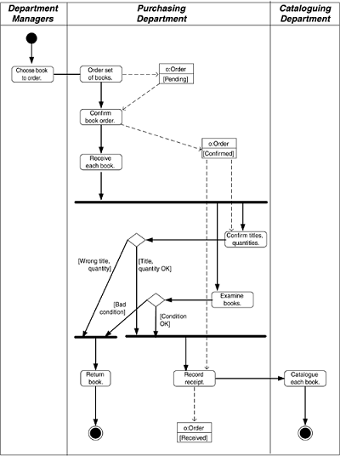
The UML Activity Diagram

Slide 38
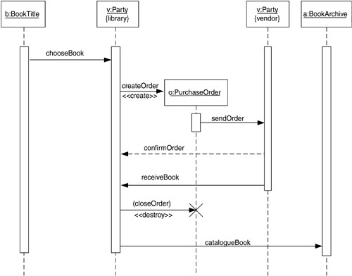
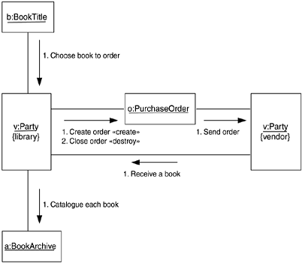
Interaction Diagrams

Slide 39
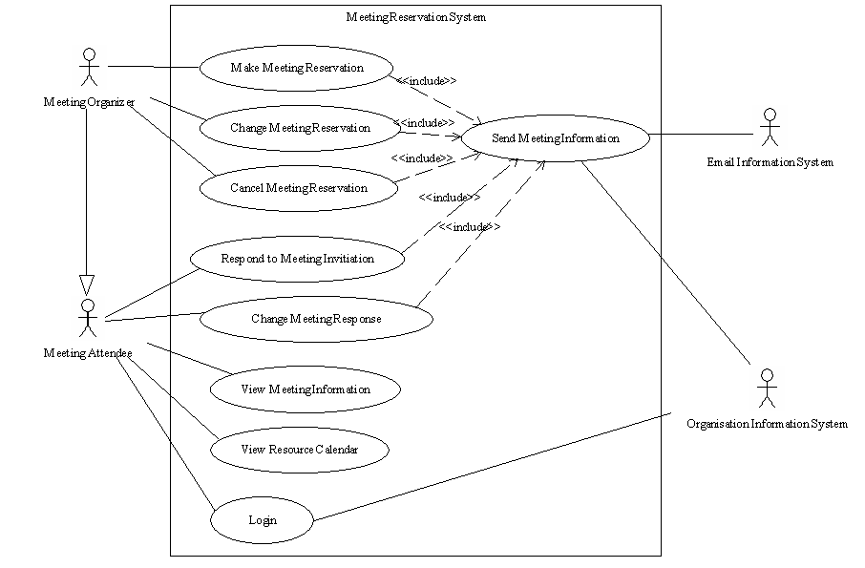
Use Cases

Slide 40
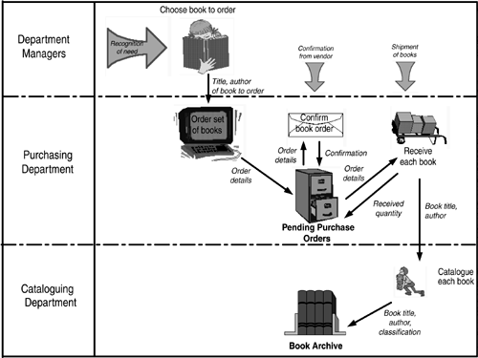
Business Process Diagrams

Slide 41

Business Security

Slide 43
5. Define What is Required from a New System
This is the "requirements" part of requirements analysis.
What motivated this project?
What specifically would make people's lives and work easier?
What kinds of technology look promising?
Key steps:
Identify Key Players: clients, users, stakeholders
Identify Missing Data
Identify Missing Functions
Propose Systems and Define Use Cases for Them
Identify Required Capabilities: functional requirements, non-functional requirements
Identify Requirement Constraints

Slide 44


Again, What Should We Do?
What is missing data?
What are missing functions?
What can you offer us?
What are business cases?

Slide 45


6. Plan for Transition
If a system that is built based on this analysis is at all significant, it will change the infrastructure of the organization.

Slide 47
Further Reading
Martin Fowler (1997). Analysis Patterns. Addison-Wesley Professional.
Andreas Luszczak (2019). Using Microsoft Dynamics 365 for Finance and Operations. Springer Vieweg.

Slide 48

Thank You & See You Again

